Slide 1
LWVNM Nuclear Issues Education
Overview
Task #1 Domestic and International Greenhouse Gas-free Energy Options
Karen M. Douglas
12/14/23

Slide 2
Domestic Power Mix (all Sources) www.eia.gov

Slide 3
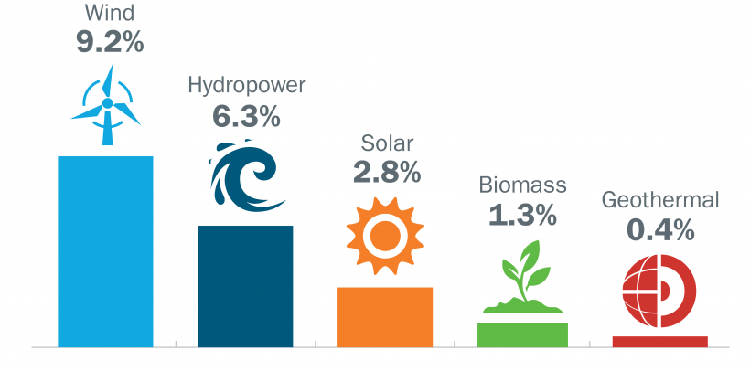
2022 Domestic GHG-Free Energy
Renewable Energy in the United States
Renewable energy generates about 20% of all U.S. electricity, and that percentage continues to grow. The following graphic breaks down the shares of total electricity production in 2021 among the types of renewable power:
In 2022, solar and wind energy are expected to add more than 60% of the utility-scale generating
Commercial nuclear power contributes 20% of the total 2022 US power mix and provides 56% of the GHG-free power in the US
Renewable Energy also contributed to total Domestic Energy 2022:

Slide 4
Domestic & International GHG-free Sources (Nuclear Costs)

Slide 5
Grid-Level Cost Comparison for Energy Sources

Slide 6
Global Nuclear Power (wna.org)
In 2022 440 nuclear plants supplied 2545 TWh of electricity internationally, down from 2653 TWh in 2021
UN COP28 Cimate Change Conference: 22 countries have signed up to the goal of tripling global nuclear energy capacity by 2050, to achieve "global net-zero greenhouse gas/carbon neutrality by or around mid-century and in keeping a 1.5 degrees celsius limit on temperature rise within reach".

Slide 7
GHG-Free Capacity Factor & Distribution
Capacity Factor is the measure of how often a power plant runs over a specific period of time. It’s expressed as a percentage and calculated by dividing the actual unit electricity output by the maximum possible output. This ratio is important because it indicates how fully a unit’s capacity is used. A plant with a capacity factor of 100% is producing power all of the time. Nuclear plants have had fewer and shorter refueling and maintenance outages and less unplanned outages.

Slide 8
GHG-Free Capacity Factor & Distribution (cont’d)
Renewable Energy Distribution considerations - Curtailment (Oversupply vs. Congestion)
Oversupply – When generation exceeds customer electricity demand.
Congestion – When power lines don’t have enough capacity to deliver available energy
During 2022 15% of CA Renewable Power (Solar & Wind) was curtailed Data source: California Independent System Operator

Slide 9
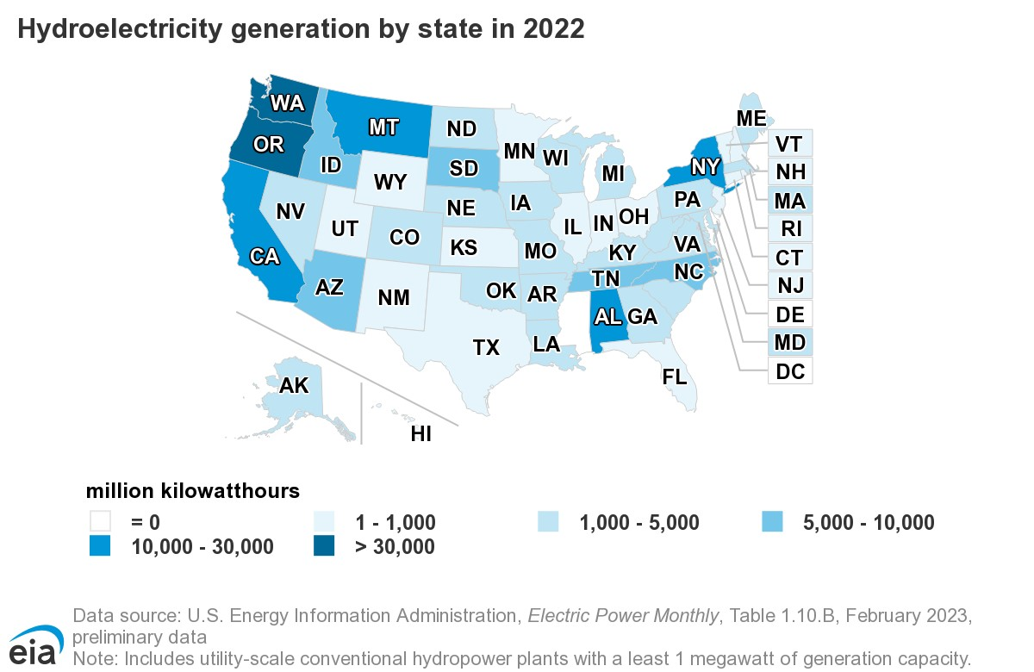
Regional Availability & Land Use for GHG-free Sources (US)
Hydropower currently accounts for 28.7% of total U.S. renewable electricity generation and about 6.2% of total U.S. electricity generation.

Slide 10
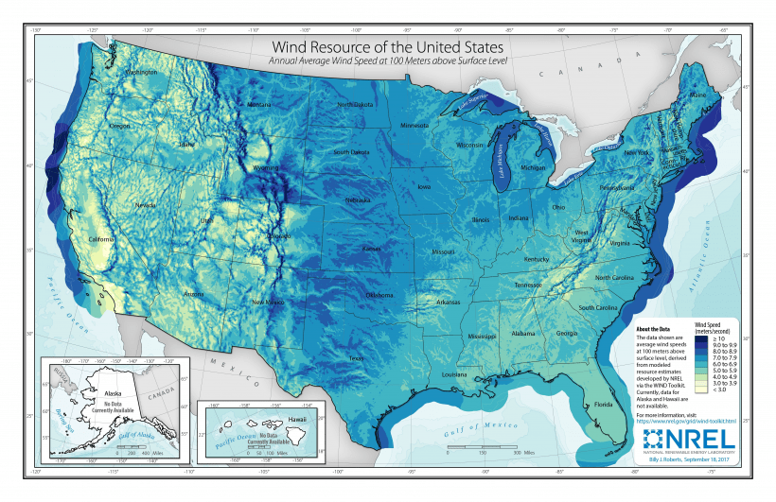
Regional Availability (Wind)
Wind resource maps provide wind energy developers and policy makers with a seamless representation of estimated U.S. wind speeds at various turbine hub heights on land and offshore.
Map from the National Renewable Energy Laboratory

Slide 11
Regional Availability (Solar)

Slide 12
Renewables – Battery Storage Factors
• Certain materials are particularly critical for the clean energy transition. These include lithium used in the batteries that run EVs, rare earth minerals in the magnets that allow wind turbines to make electricity, and copper, which is used for electricity transmission. MIT Climate Portal
Total Carbon Footprint for Batteries - Currently, most lithium is extracted from hard rock mines or underground brine reservoirs, and much of the energy used for extraction and processing comes from fossil fuels. Particularly in hard rock mining, for every ton of mined lithium, 15 tons of CO2 are emitted into the air.
• The vast majority of lithium-ion batteries (about 77% of the world’s supply) are manufactured in China, where coal is the primary energy source. (Coal emits roughly twice the amount of greenhouse gases as natural gas.)

Slide 13
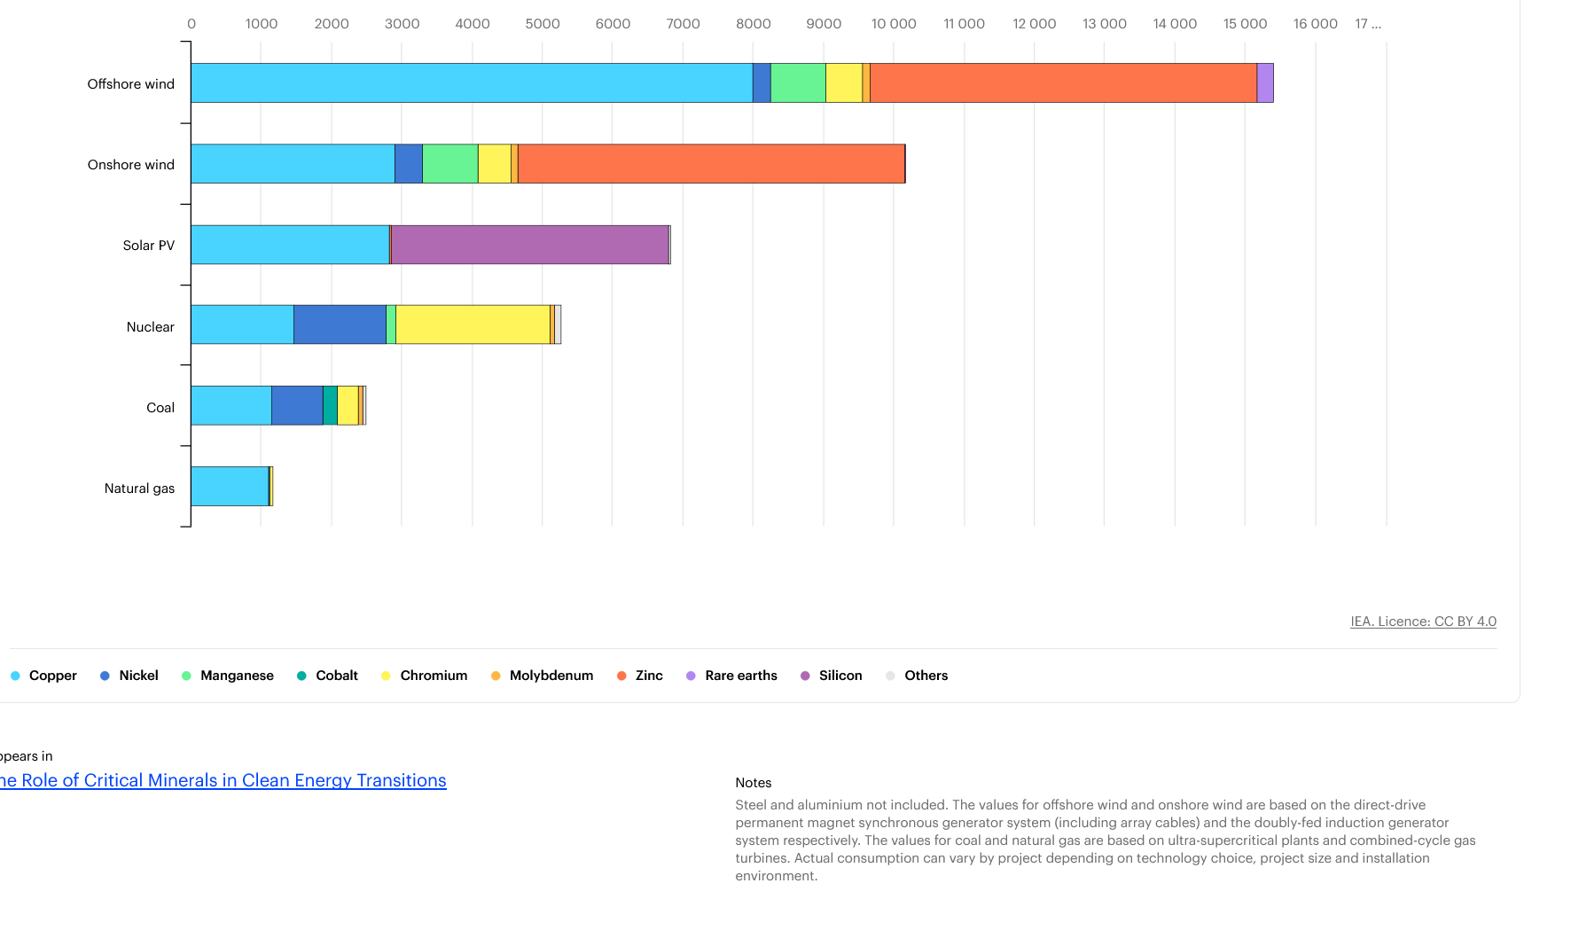
Mineral Needs for Energy Sources (IEA)

Slide 14
Mining for Renewable Energy | MIT Climate Portal
Mining, climate change, and socio-environmental conflict - pinpointing the worst harms is tough, but land-use change and freshwater contamination and scarcity are major concerns.
Mining companies don’t just drain local water sources; they can contaminate clean supplies, too.
Mineral mining waste. In the U.S., copper mining makes up the largest percentage of metal mining and processing waste.
Waste storage piles can be as large as 1,000 acres.
Waste is typically stored in isolated areas called tailing ponds
Tailings Ponds fail (especially in the face of natural hazards like floods and earthquakes), sending toxins into nearby water systems
Associated Press report from 2019 found that more than 50 million gallons of contaminated wastewater from U.S. mines flow into local water sources every day.⁴

