Slide 1
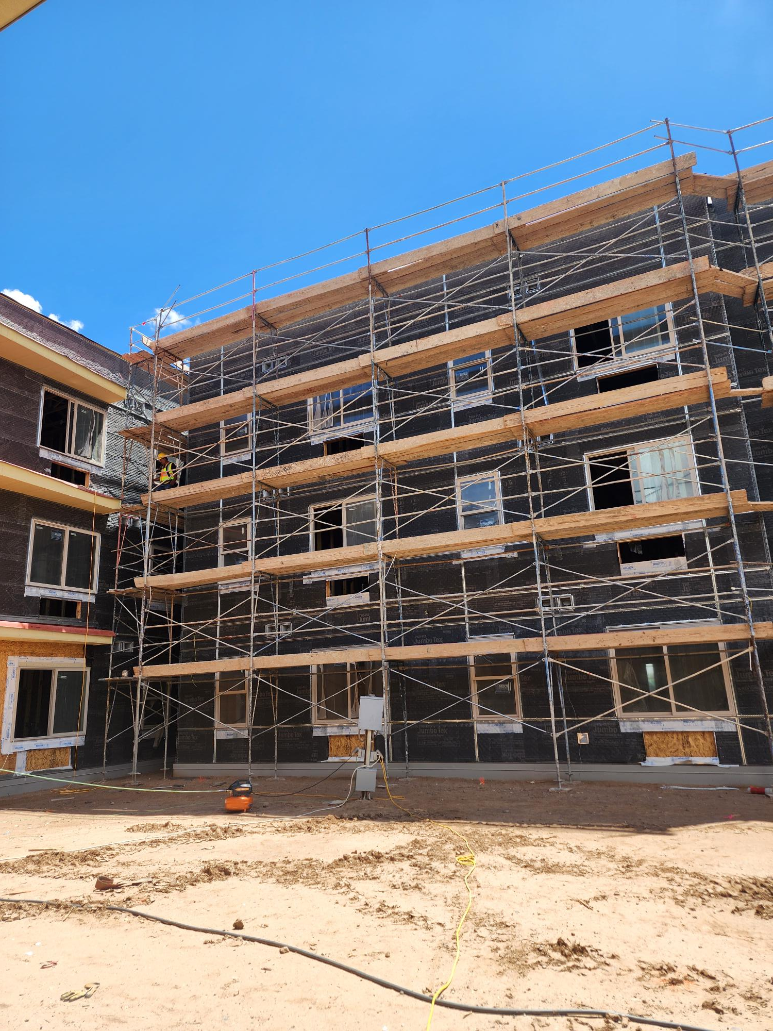


League of Women Voters of
Central NM
June 2026

Slide 2
Office of Housing Overview
Housed within the NM Department of Workforce Solutions
Focused on deploying resources to proven strategies, promoting best practices, and working with all segments of the community who are engaged in housing and homelessness issues
Our team:
  Lisa Huval, Housing Initiatives Manager
  Maria Wolfe, Homelessness Initiatives Manager
  Roslyn Gallegos, Senior Project Manager
  Forrest Dudeck, Senior Project Manager
  Jeremy Barker, Housing Stability Coordinator
  Gabriel Quiroz, Workforce Development Specialist
2

Slide 3
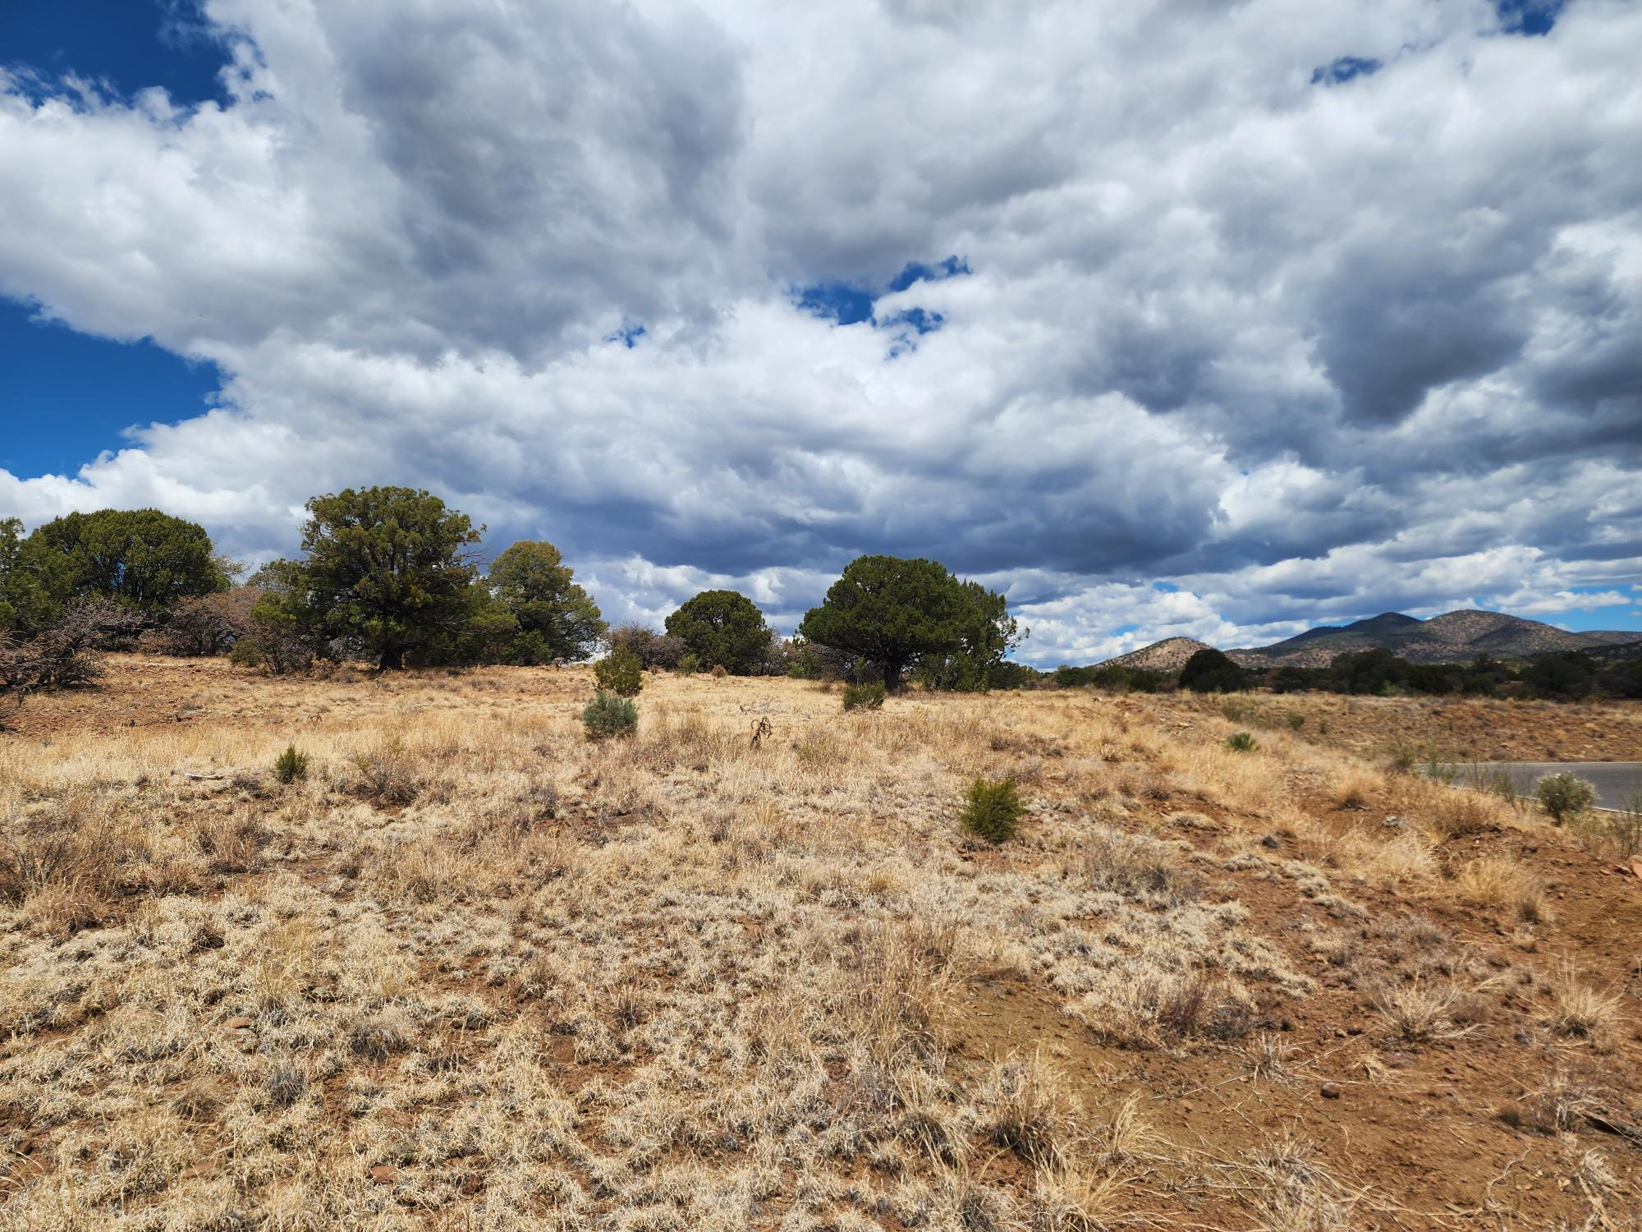
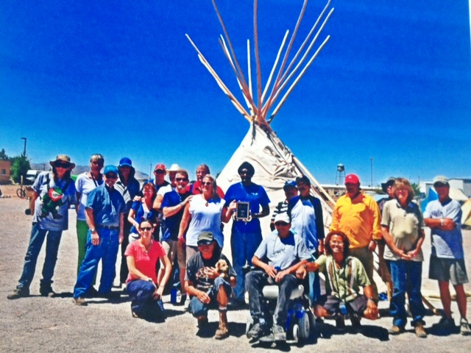
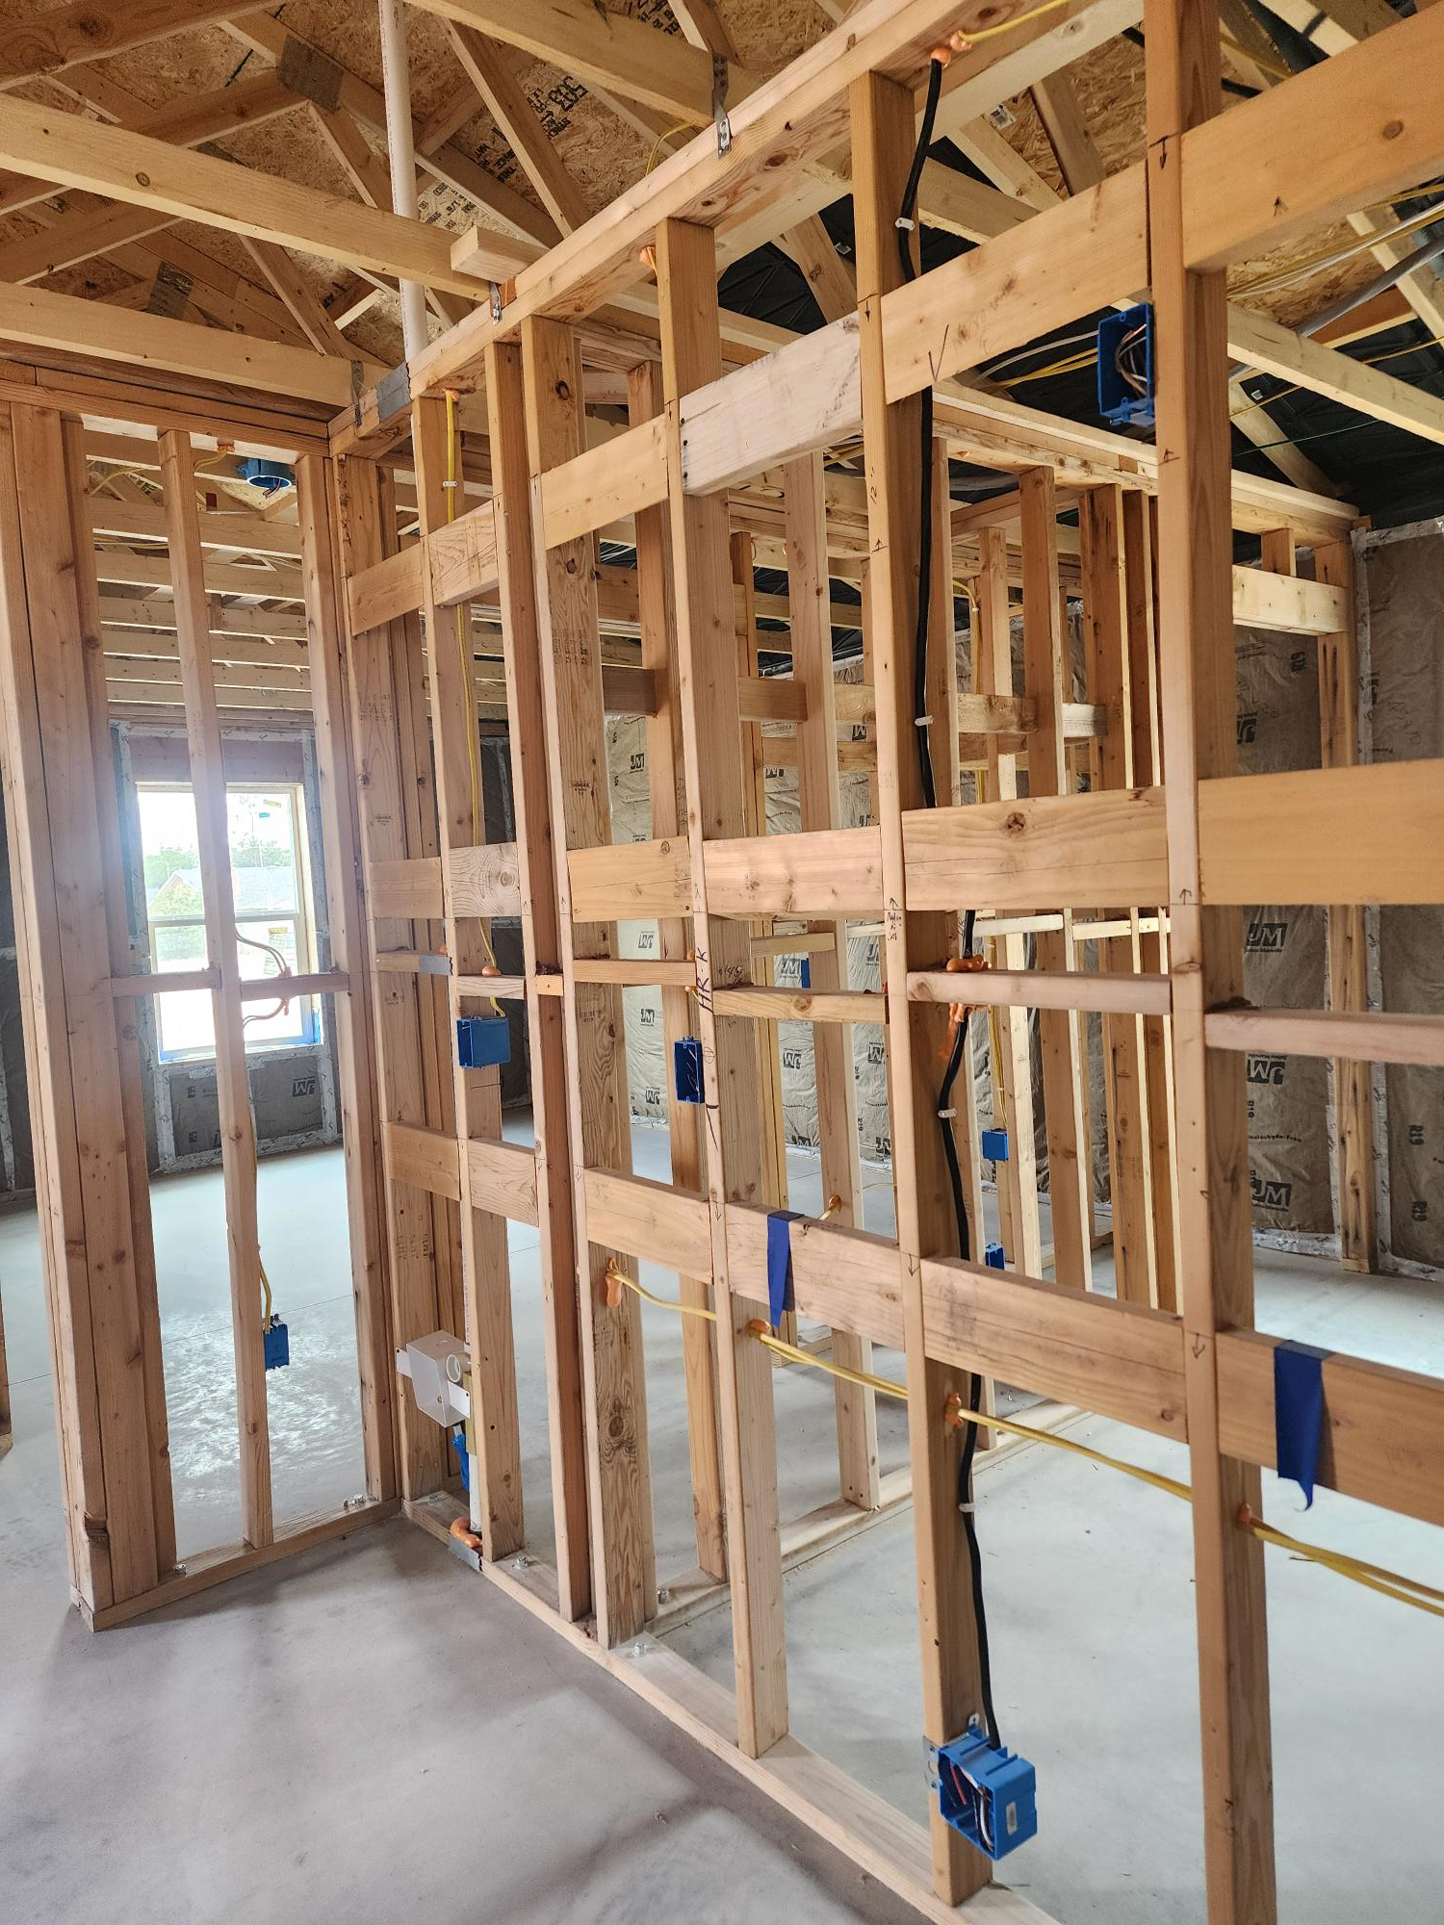
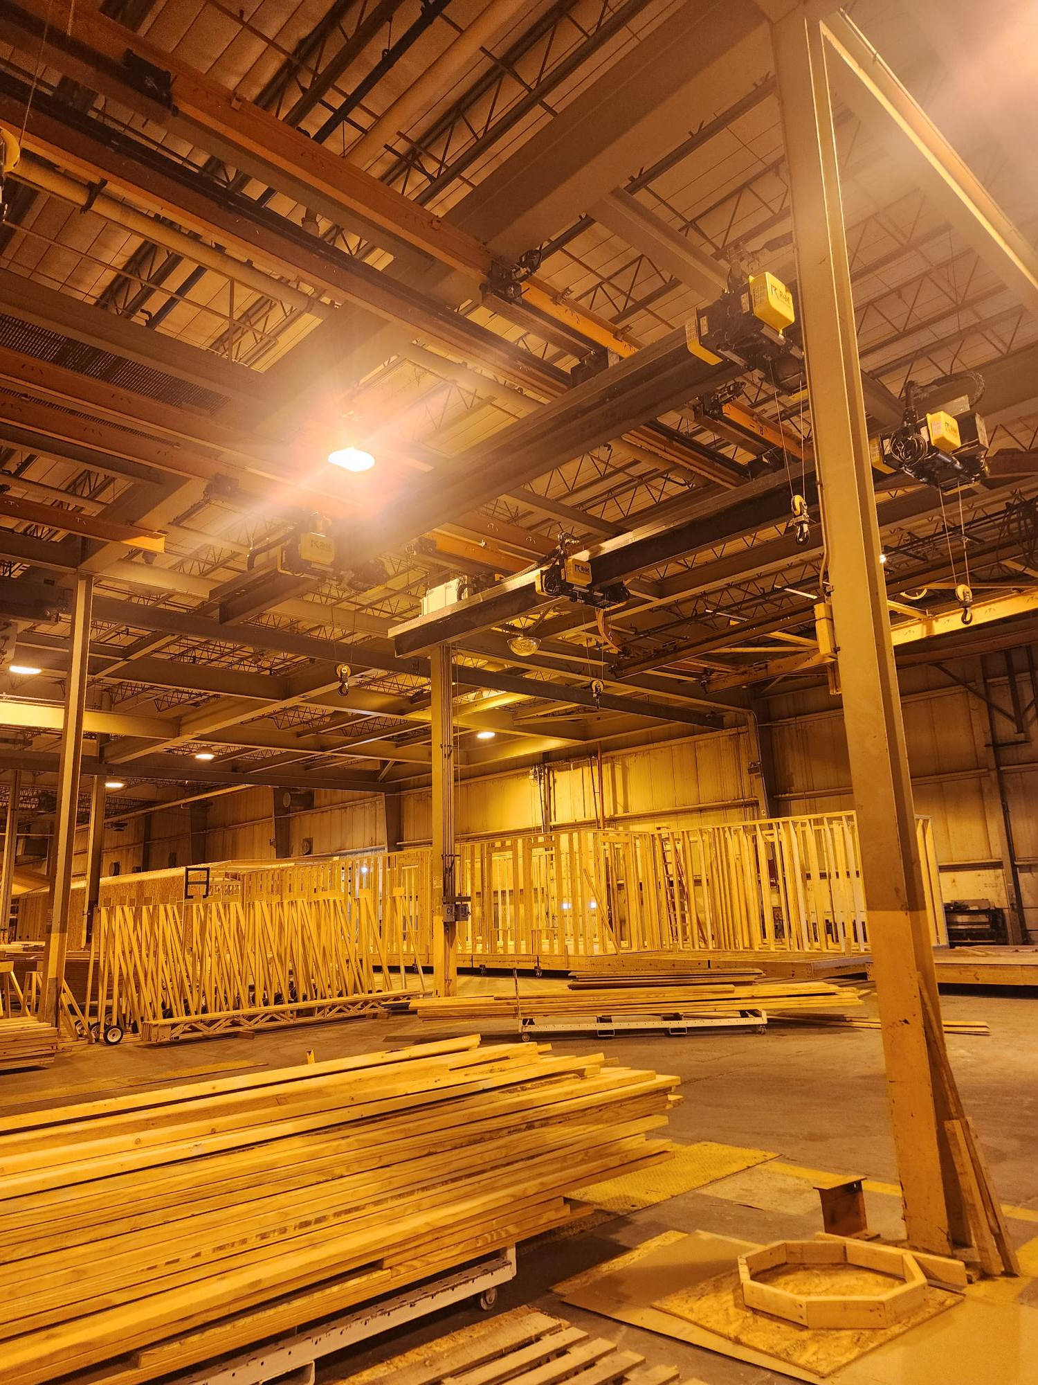
We know what works. We need to do more of it.
3

Slide 4
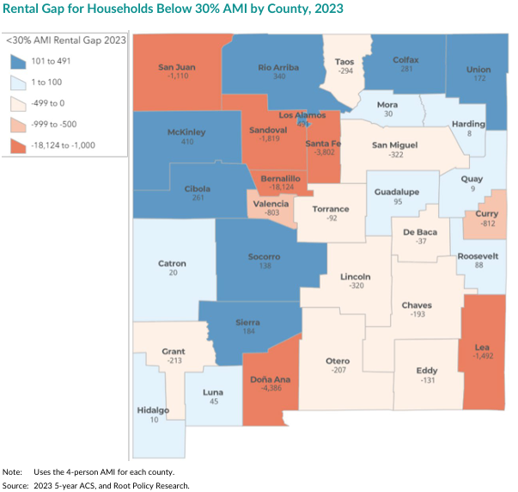
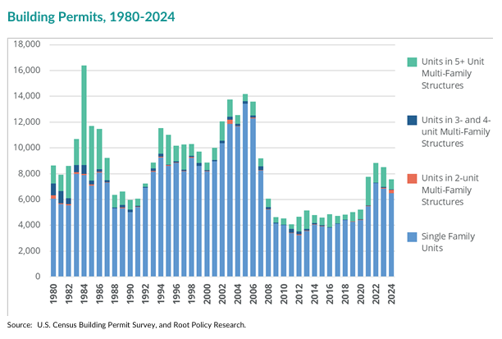
Lack of Housing Supply is Driving Up Housing Costs
Source: New Mexico Housing Strategy: A Call to Action 2026 Update, Housing NM, New_Mexico_Housing_Strategy_2026_Update.pdf
4

Slide 5
Lack of Housing Supply is Driving Up Housing Costs
New Mexico will need nearly 58,000 new housing units by 2045 to accommodate projected household growth
~39,000 homeownership units needed
~19,000 rental units needed
40% of those units need to be affordable to households at or below 80% Area Median Income
Need is heavily concentrated in Bernalillo, Sandoval, Dona Ana and Santa Fe Counties.
5

Slide 6

Building more housing works. We need to do more of it.
More affordable and attainable housing for sale
More down payment and homebuyer assistance
More affordable and attainable rentals
More supportive housing
More infrastructure funding
More reliable, multi-year funding
More zoning and permitting changes to foster housing development
6

Slide 7
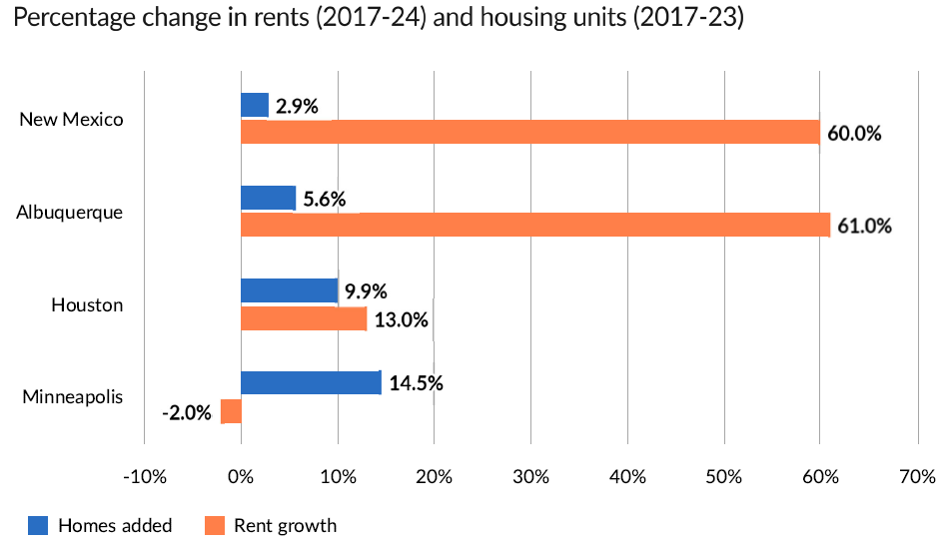
Building more housing works. We need to do more of it.
Source: ”Restrictive Regulations Fuel New Mexico’s Housing Shortage,” Alex Horowitz, Pew Charitable Trusts (2025)
7

Slide 8


Affordable Housing Challenges
SUPPLY
DEMAND
Land
Loans
Grants
Infrastructure finance
Tax incentives
Down payment & closing cost assistance
Low-interest loans
Purchase price subsidies
When supply goes down, rents and purchase prices go up
=
Zoning and permitting changes
Regional housing plans
Diversified housing types
Construction workforce programs
Technology
Homebuyer education
Credit counseling
Inventory to accommodate mobility
Economic stability
Markets ♥ Predictability
8

Slide 9
What Works
Intergovernmental Agreements
Program Gap Funding
Data and Monitoring
Community Collaboration
9

Slide 10
Office of Housing Funding Overview
Source | Amount
HB2 (2024) Office operating budget balance of $2M appropriation | $139,091
HB2 (2025) Office operating budget | $2,000,000
HB2 (2025) To support housing, affordable housing, transitional housing and the expansion of housing services providers that facilitate behavioral health services and substance abuse recovery, homelessness assistance and prevention for persons with behavioral health needs | $110,000,000
HB2 (2025) For grants to local governments to support homeless encampment response | $5,000,000
HB2-GRO (2024) For Statewide Homeless Initiatives balance | 19,106,248
YHSI grant (DFA holds funding) | $1,861,001
Capital outlay for statewide housing projects (DFA administers) | $13,500,000
Capital outlay for housing in Bernalillo and Santa Fe County balance of $7M appropriation in 2023 (DFA administers) | $4,930,000
Total Non-Operating | $154,397,249
10

Slide 11
Affordable / Attainable Housing Development Projects
Albuquerque / Bernalillo County | Award | Affordable Units
Aldea del Rio* | $ 3,000,000 | TBD
CABQ Affordable Housing | $ 3,100,000 | 40
Cottages at 161 Chama* | $ 1,800,000 | 20
Planning for State Fairgrounds | $ 380,000 | N/A
Poblana Place Apartments* | $ 17,850,517 | 84
Sombre del Oeste* | $ 1,500,000 | 14
Tierra Linda* | $ 6,000,000 | 240
Uptown Connect | $ 1,000,000 | 175
Wells Fargo Building* | $ 10,000,000 | 100
West Mesa Ridge A* | $ 3,500,000 | 128
West Mesa Ridge B* | $ 10,000,000 | 144
Grand Total | $ 58,130,517 | 945+
Statewide | Award | Affordable Units
Carlsbad Chesterfield Acres Project | $ 1,612,000 | 26
Gallup Housing Authority | $ 300,000 | 8
Hobbs Habitat for Humanity Project | $ 860,000 | 14
Los Alamos Coyote Mesa Project | $ 4,964,800 | 98
Red River Affordable Housing Project | $ 1,600,000 | 30
Ruidoso Workforce Housing Project | $ 5,374,500 | TBD
Santa Fe Las Estrellas Project | $ 4,490,000 | 78
Santa Fe Arroyo Oeste Project | $ 6,500,000 | 20
Santa Fe County Affordable Housing | $ 2,000,000 | TBD
Taos County Workforce Housing | $ 5,200,000 | TBD
Valencia County Affordable Housing | $ 1,800,000 | TBD
Grand Total | $ 34,701,300 | 274+
Las Cruces | Award | Affordable Units
Arcadia 4 Subdivision | $ 3,250,000 | 52
Peachtree Phase I | $ 4,300,000 | 144
Pedrena Senior Apartments | $ 400,000 | 80
Skylark Subdivision | $ 1,400,000 | 32
Grand Total | $ 9,350,000 | 308
Rental projects in purple
Homeownership projects in blue
Rental or homeownership mixed or TBD in black
* Bernalillo County administering

Slide 12
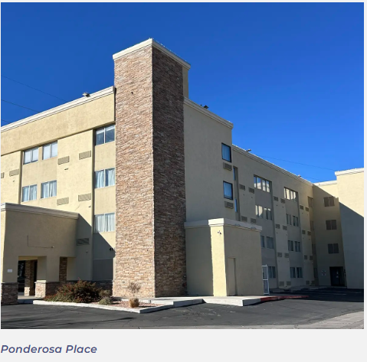
Supportive Housing & Youth
Supportive Housing | Investment | Units
Amador Crossing (Las Cruces) | $ 1,725,000 | 50
Cornerstone Apartments (Silver City) | $ 3,000,000 | 30
Ponderosa Place (Bernalillo County) | $ 7,172,320 | 76
Youth | Investment | Beds or Families Served
ABQ Young Adult Housing and Treatment Navigation Center | $ 862,500 | 41 beds
Family Stabilization Pilot Project | $ 4,850,000 | ~470 families
Statewide Youth Housing System Improvement grant | $ 1,998,455 | N/A
Grand Total | $ 5,460,955

Slide 13
Homelessness
Albuquerque | $ 15,977,104
Gateway @ Gibson First Responder Receiving Area Operations | $ 1,289,736
Gateway @ Gibson Men's Housing and Treatment Navigation Center | $ 1,350,000
Gateway @ Gibson Men's Housing and Treatment Navigation Center Expansion | $ 1,350,000
Gateway @ Gibson Roof Repair | $ 2,971,865
Gateway @ Gibson Women’s Housing And Treatment Navigation Center Expanded Operations | $ 1,350,000
Gateway West Capital | $ 400,000
Gateway West Operations | $ 6,103,003
Gateway Shared Costs | $ 1,162,500
Santa Fe Agape House and Street Outreach | $ 1,200,000
Code Blue | $ 824,196
Grand Total | $ 18,001,300
Emergency Shelter
Program | Award | People/Households Served
Bernalillo County Home Repair | $ 1,000,020 | 27 households
Bernalillo County Rapid Rehousing | $ 2,585,453 | ~825 households
Las Cruces Landlord Risk Mitigation Fund | $ 100,000 | 71 households
Grand Total | $ 3,685,453 | ~923 households
Prevention

Slide 14
Homelessness
Program | Award
Bernalillo County - Social Service Support | $ 293,000
Las Cruces – Acquisition of Building for Outreach Services | $ 850,000
Santa Fe County Life Link – Transitional Housing for Human Trafficking Victims | $ 250,000
Statewide Balance of State COC Funding | $ 470,000
Three City Street Outreach and High Utilizers Contract | $ 1,140,666
Grand Total | $ 4,346,126
Services

Slide 15
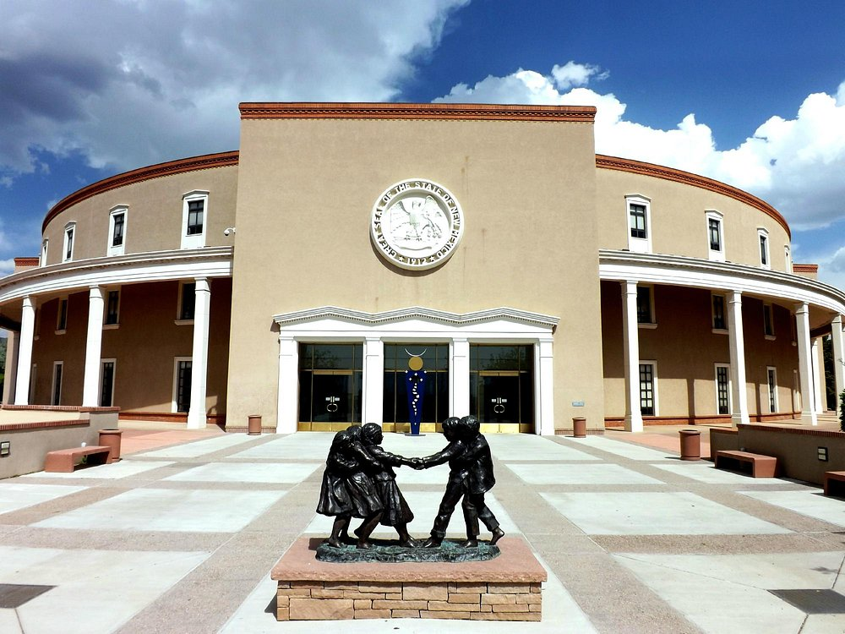
2026 Legislative Session
DWS Office of Housing
Three years of operational funding
$30 million in general fund for housing and homelessness projects statewide
$26.5 million in capital outlay for housing and homelessness projects statewide
$5 million for rental assistance
HB 200 New Homes for New Mexicans
GRT deduction for affordable housing projects
15

Slide 16
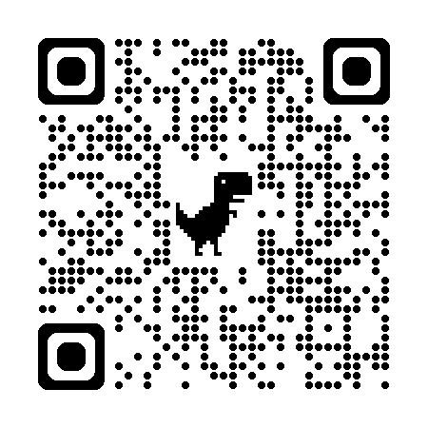
Funding Opportunities for Housing & Homelessness
RFI for Housing Development Projects in Partnership with Governmental Entities:
Deadline: Rolling until all funds awarded
Recommended Request Amount: $500,000 to $5,000,000
Eligible Projects: Attainable Housing, Affordable Housing, Permanent Supportive Housing and Transitional Housing
RFI for Cooling Centers & Street Outreach
Deadline: June 15, 2026, for FY27 funding
Recommended Request Amount: $Up to $20,000
Eligible Projects: Cooling centers that provide a safe place for people to go during extreme heat and outreach services that alleviate exposure during periods of extreme heat
All DWS Office of Housing Funding Opportunities
16

