Slide 1

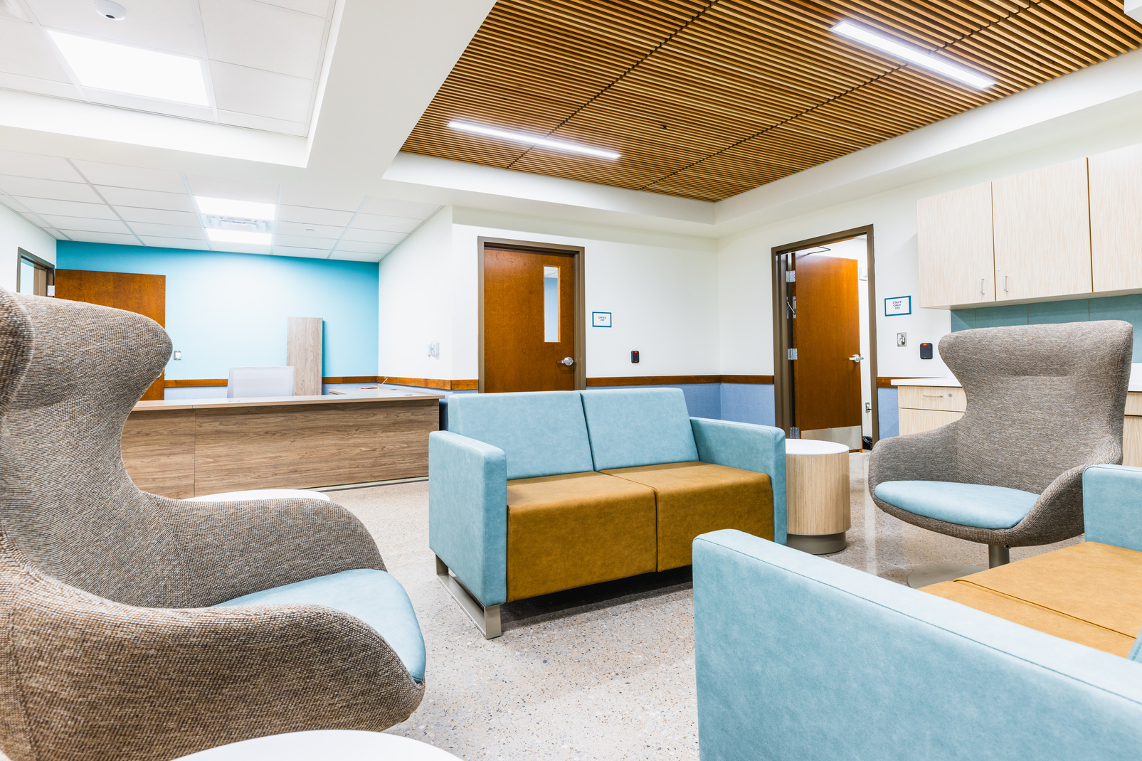
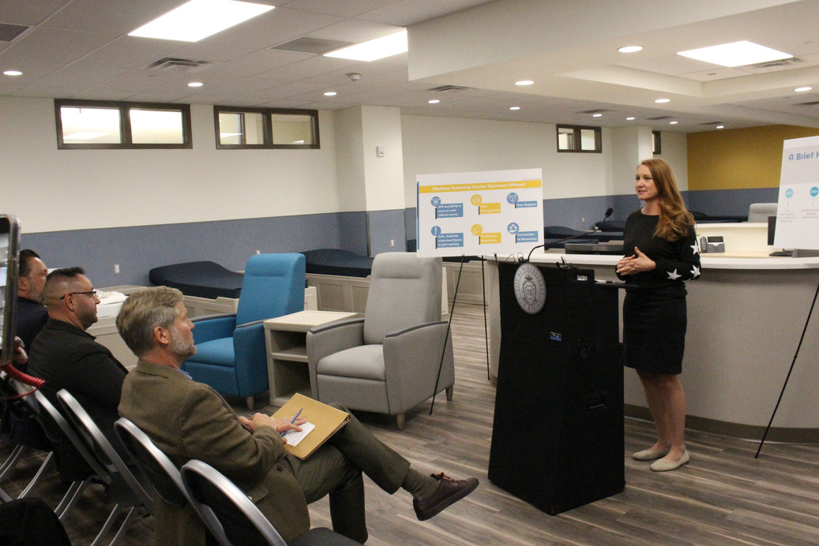
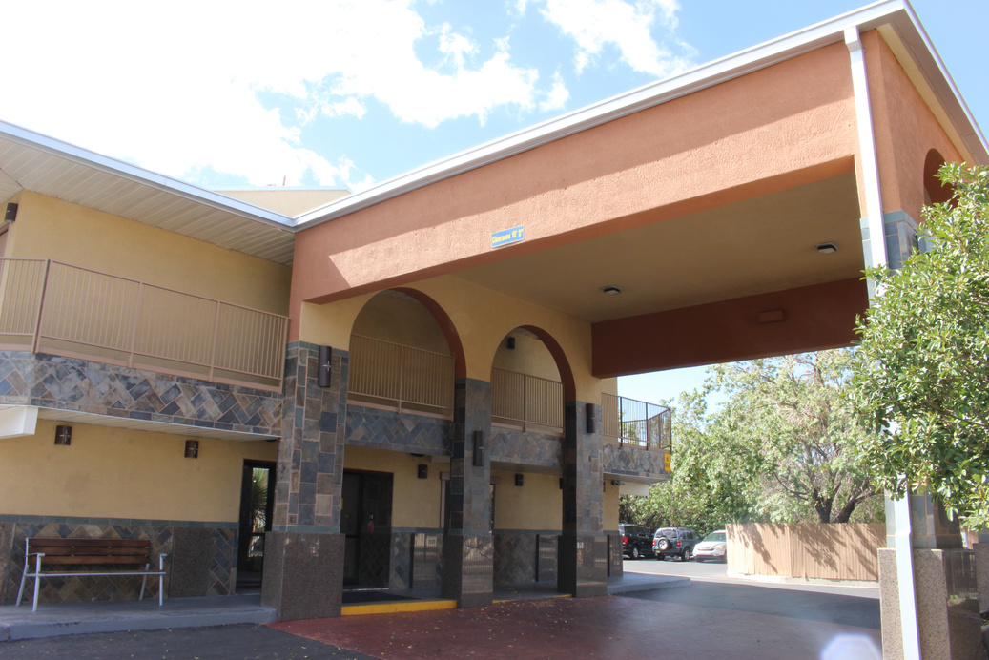
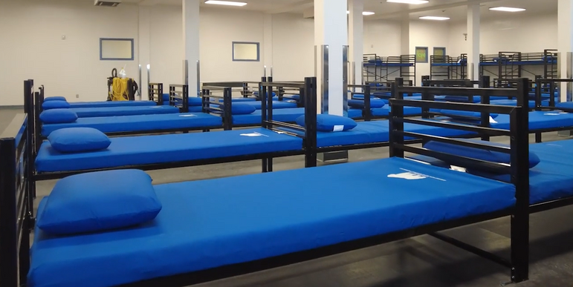
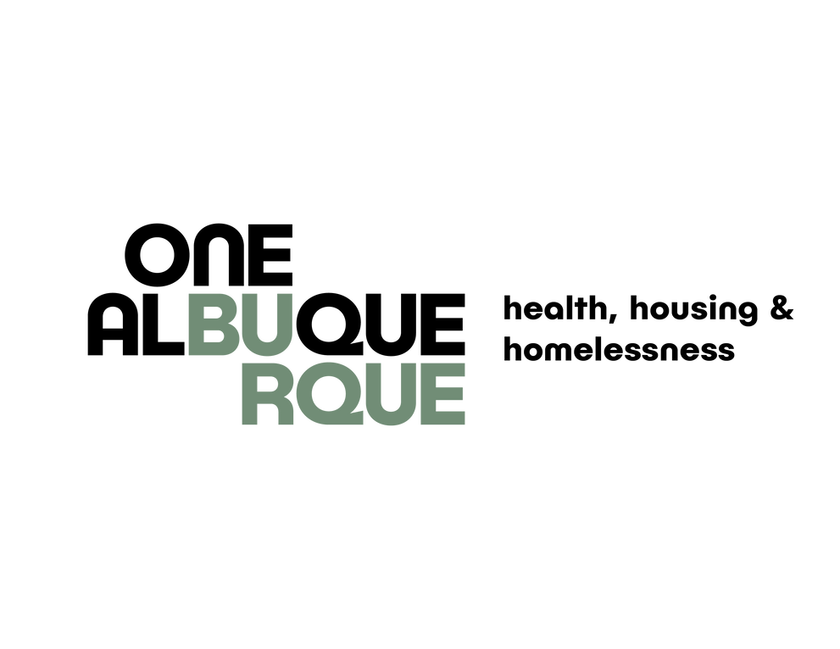
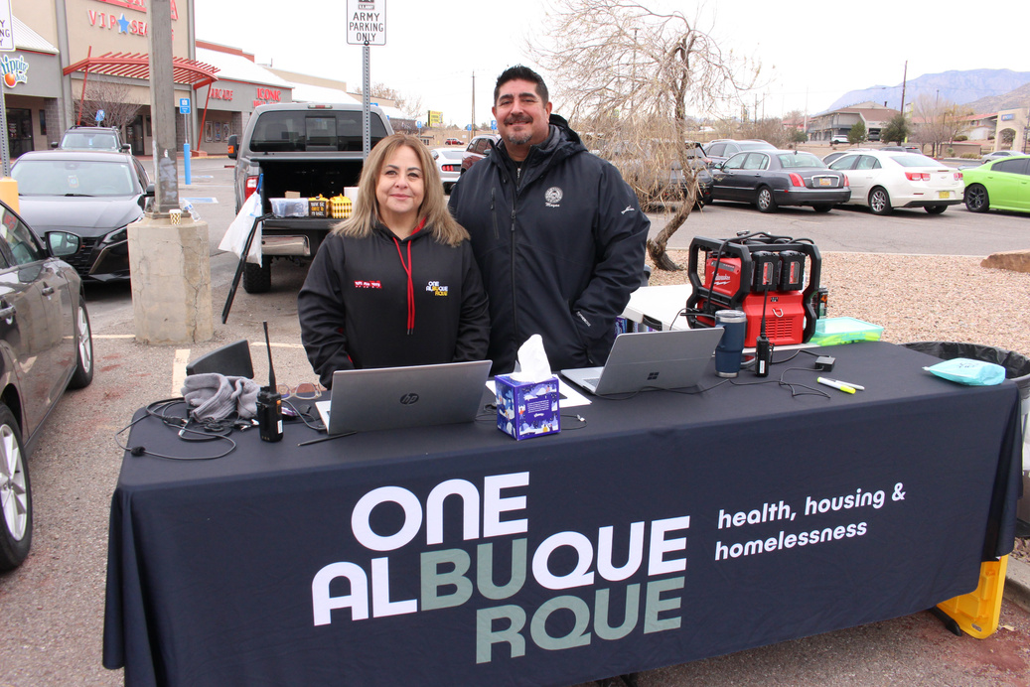
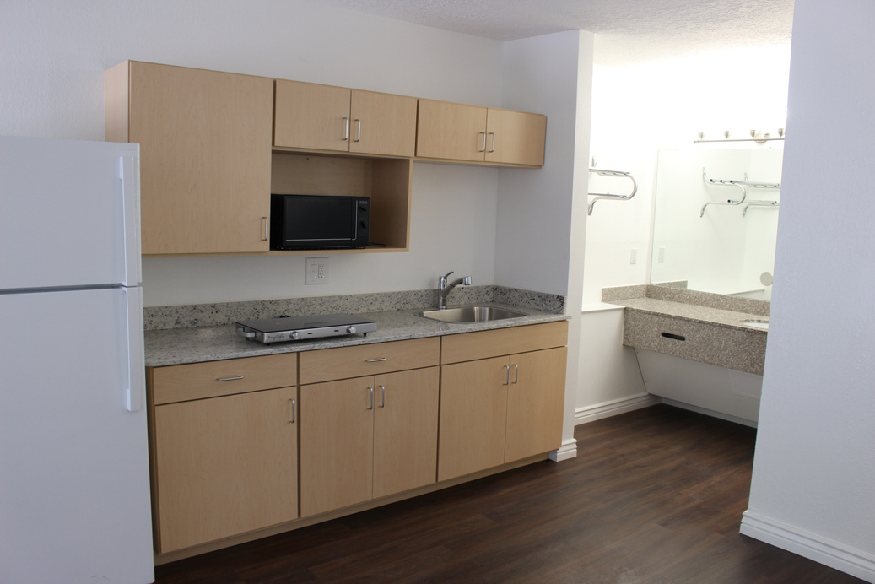

Slide 2

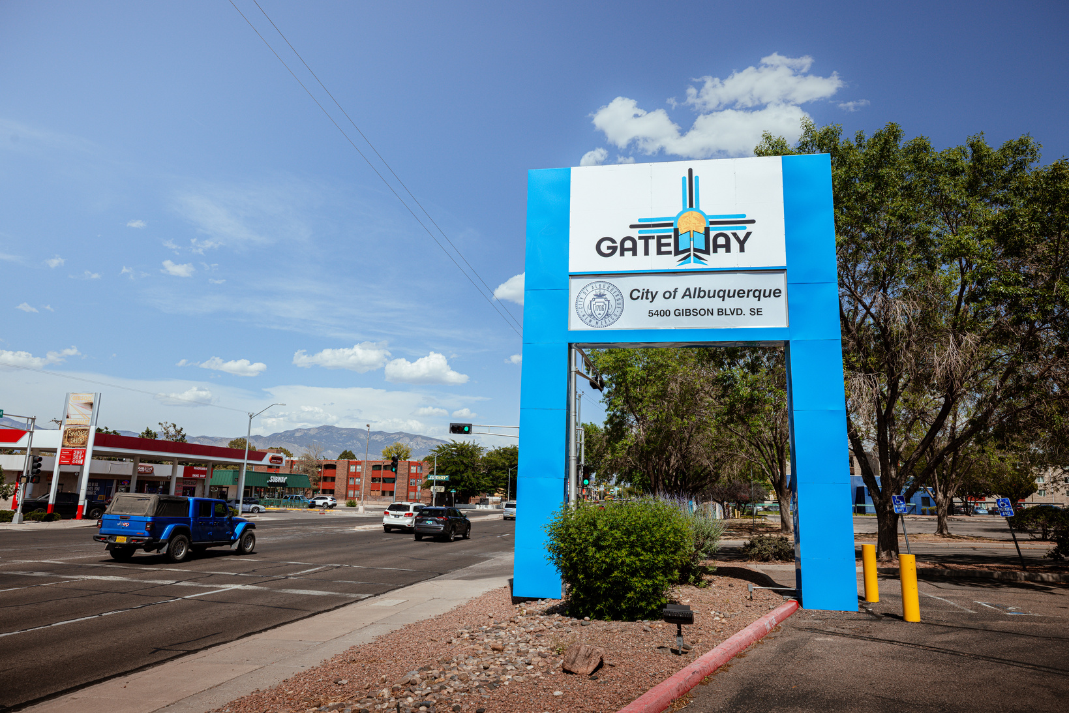
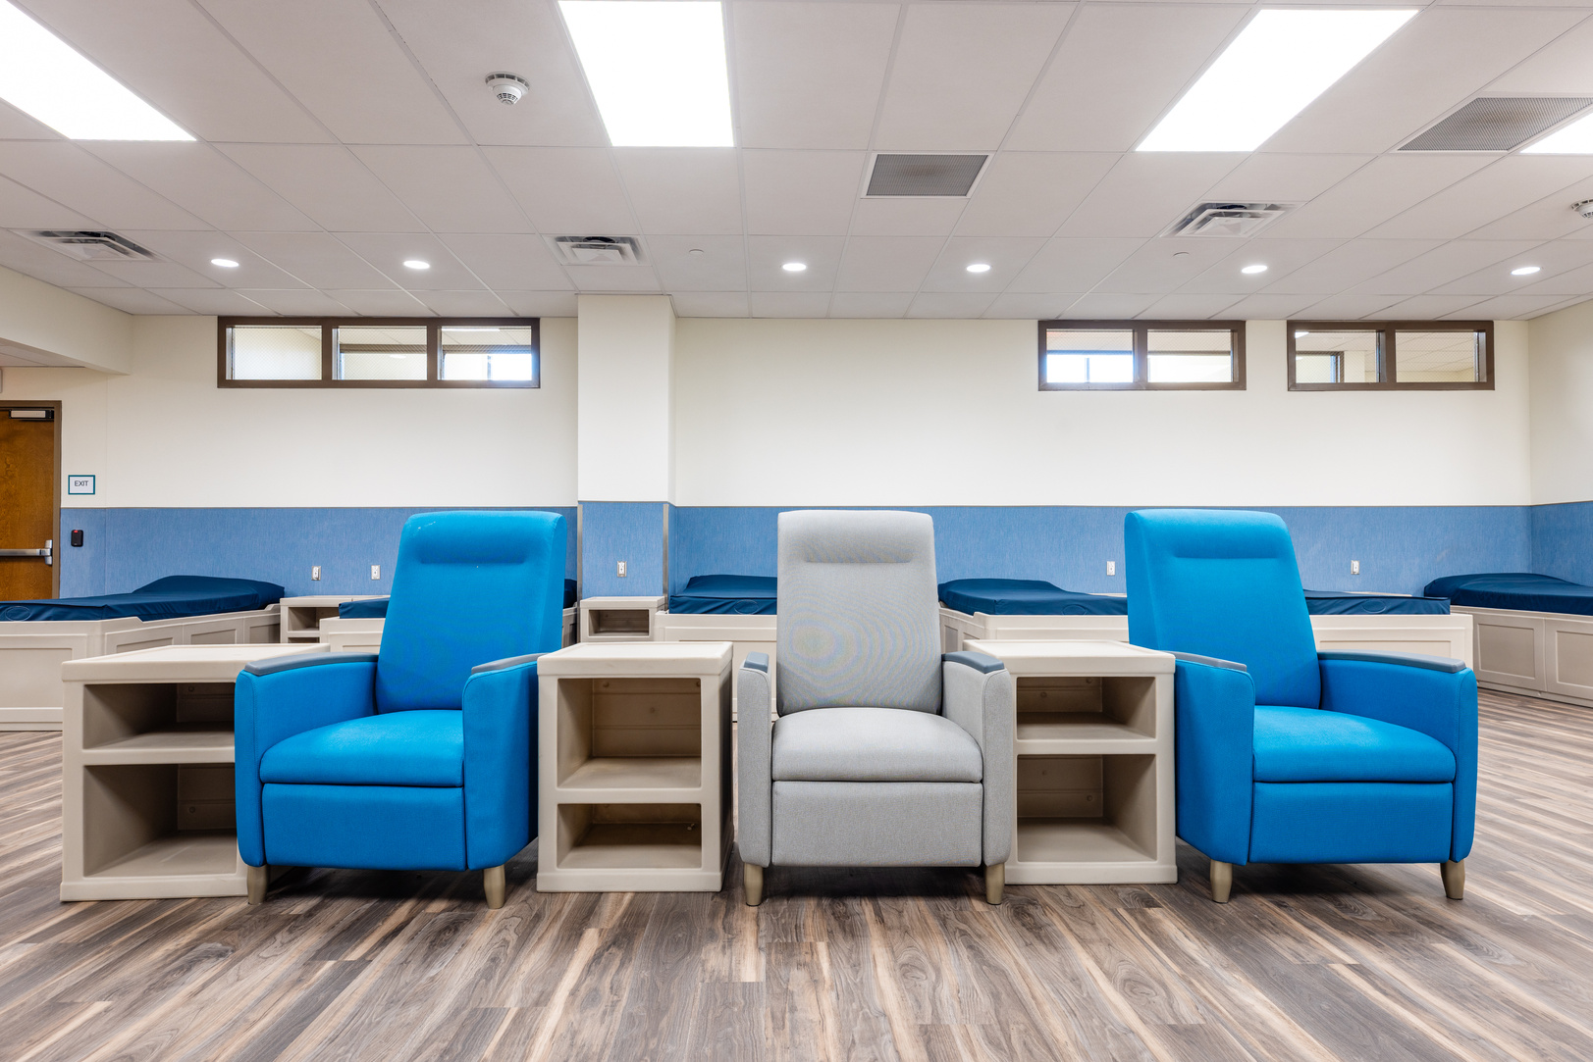
Overview
What Gateway programs exist, how do they work, how do you refer to them and contact them?

Slide 3

Gateway System of Care
Notes:
Connection for ACS, AFR, and other First Responders
Open 8 p.m. - 2 p.m.
Case Management: works with clients to plan next steps
Includes connection to other Gateway Network Services
Only low-barrier overnight option

Slide 4
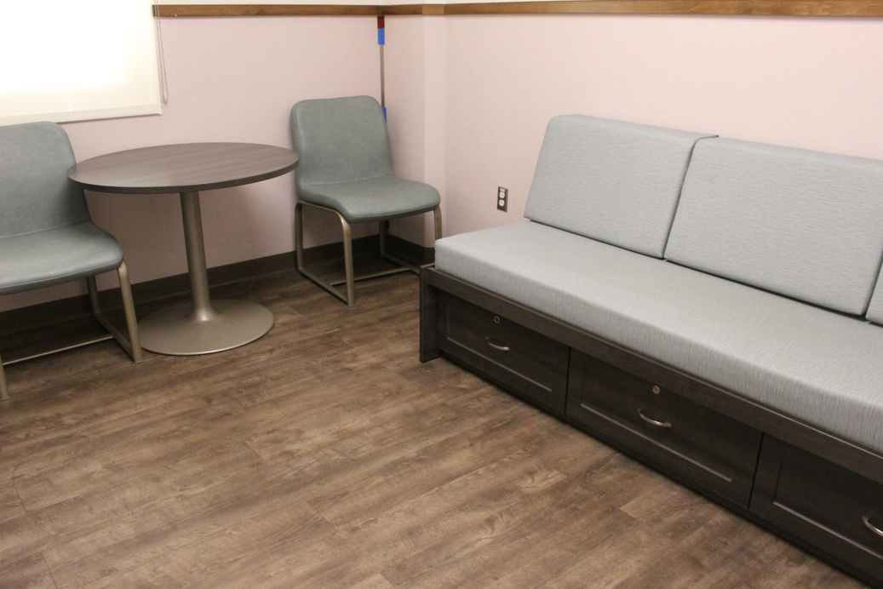
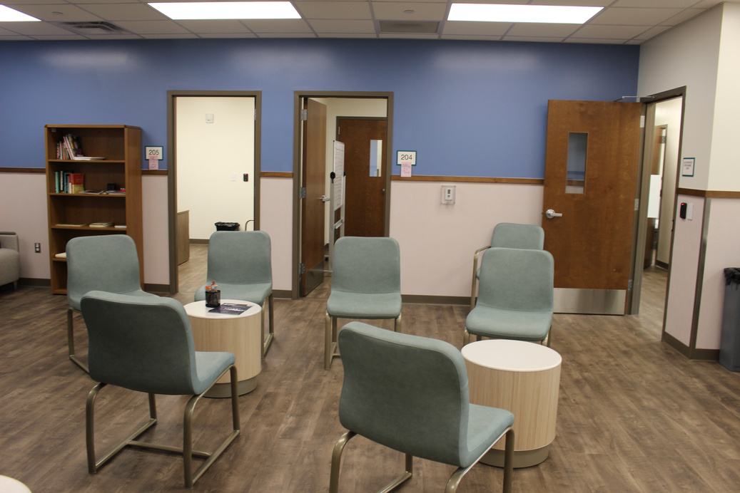
Gateway Center
First Responder Receiving Area
  Connection for ACS, AFR, and other First Responders
  Open 8 p.m. - 2 p.m.
  Case Management: works with clients to plan next steps
    Includes connection to other Gateway Network Services
  Only low-barrier overnight option
Notes:
Connection for ACS, AFR, and other First Responders
Open 8 p.m. - 2 p.m.
Case Management: works with clients to plan next steps
Includes connection to other Gateway Network Services
Only low-barrier overnight option

Slide 5

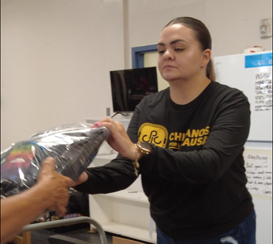
Gateway West
  New Mexico’s Largest Shelter
  Can serve up to 660 people per night
  3,354 admissions in FY25
  Daily bus service to the shelter
  Provides case management, transportation to appointments, and medical checkups
  Connection to other Gateway services
  Became a 24/7 shelter in 2021

Slide 6
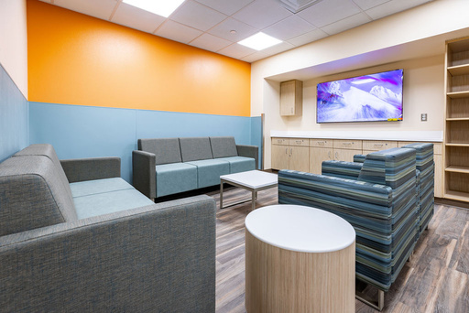
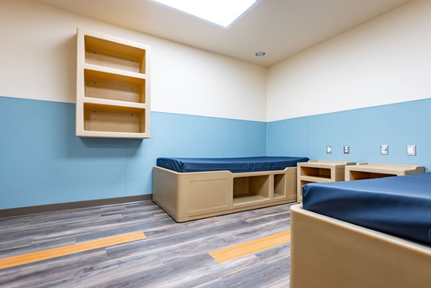
Gateway Center
Housing and Treatment Navigation
  Opened August 2023
  192 beds
  Referral-based, 90-day program
  Offers Case Management and other Key Supports
  Access to treatment, including substance use disorder treatment
  Connection to a Housing Voucher

Slide 7
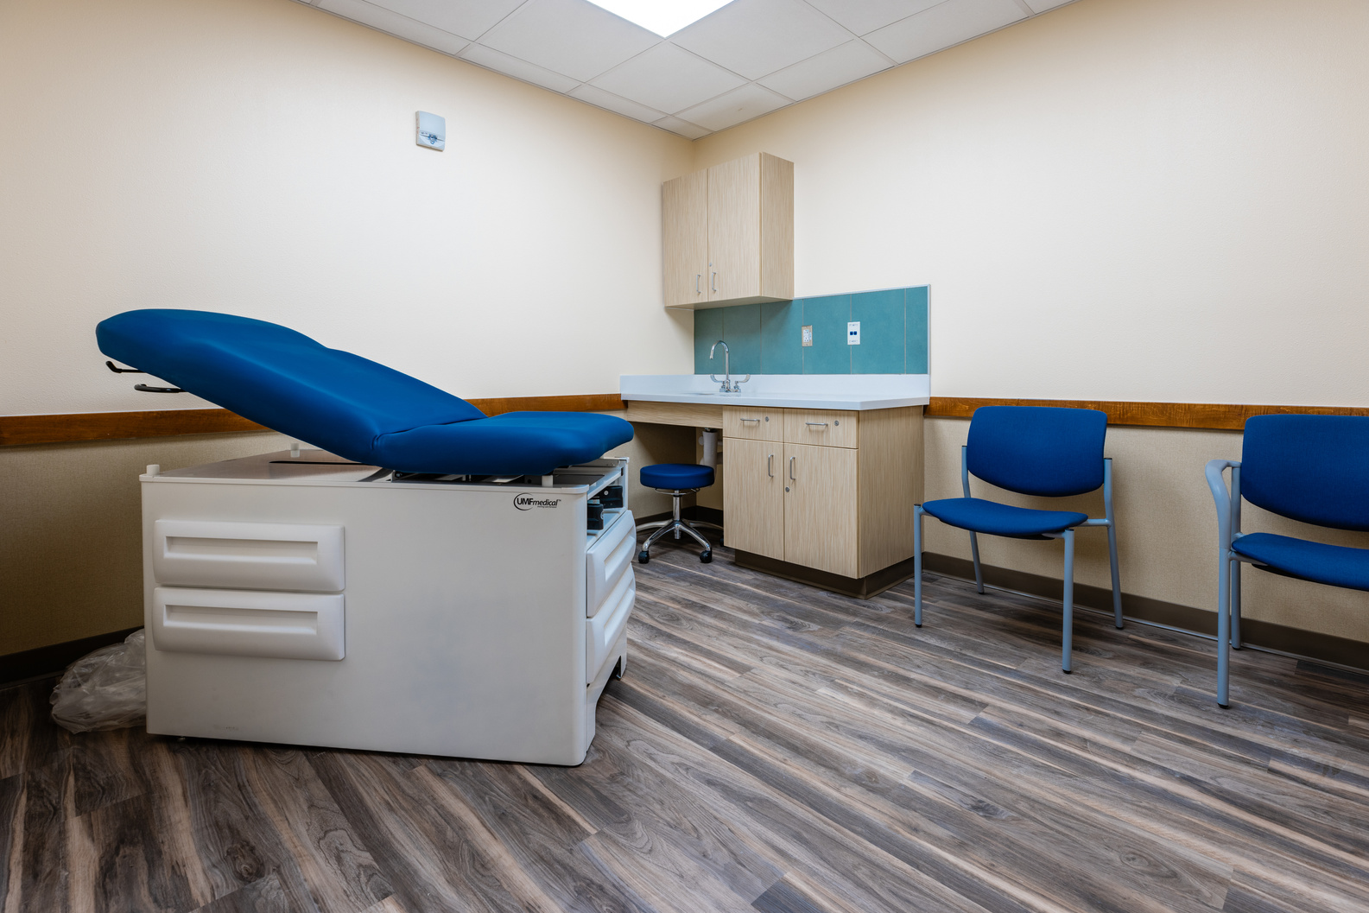
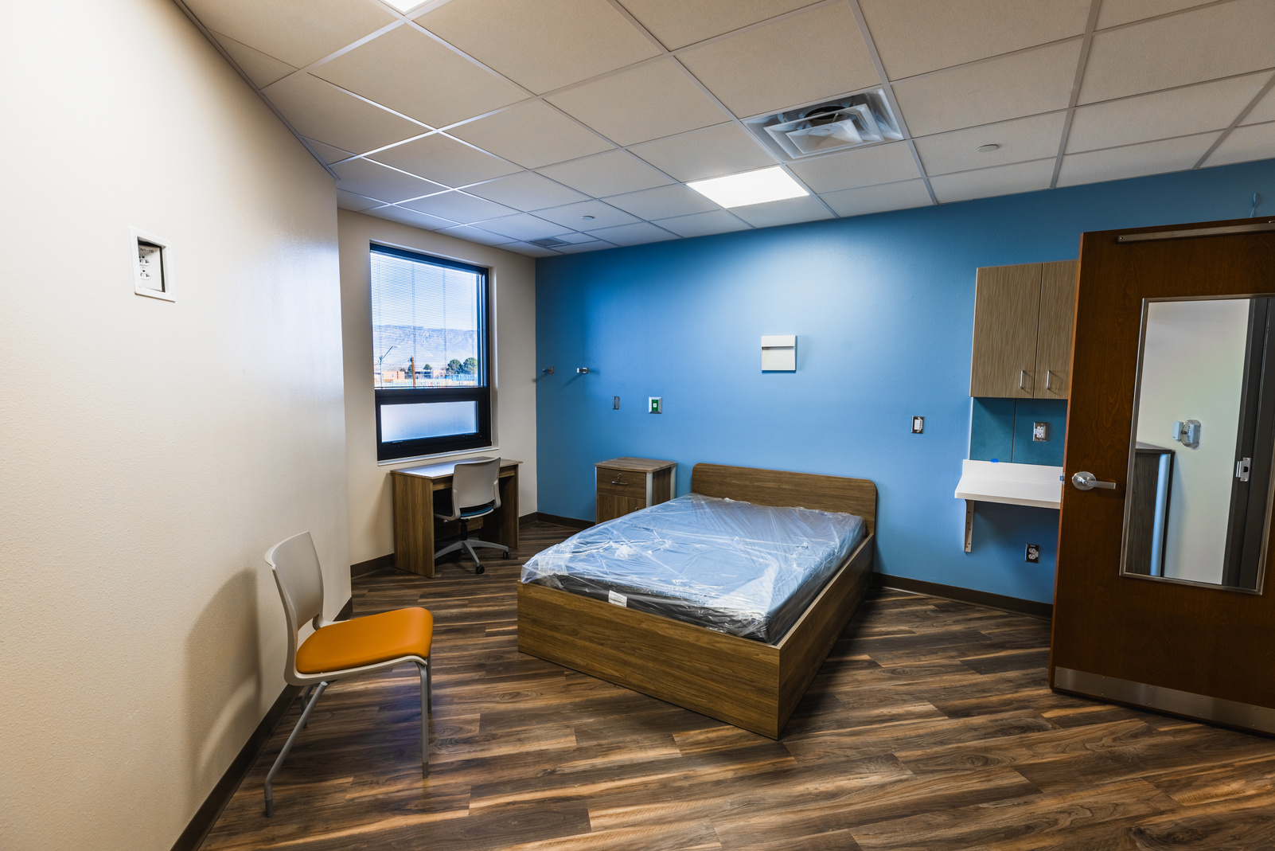
Gateway Center
Medical Respite Center
  Appropriate space for unhoused neighbors to recover from illness or injury
  Opened February 2025
  50 beds
  Referrals from UNM-H
  Medical check-ups, case management, and access to substance use disorder treatment
  Connection to a Housing Voucher

Slide 8
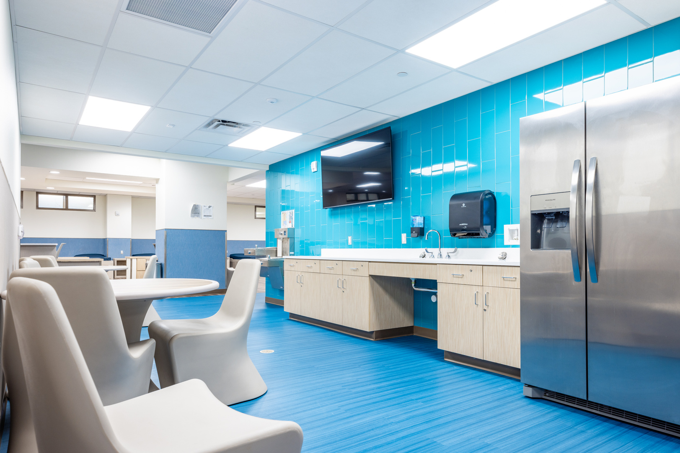
Gateway Center
Medical Sobering Center
  Safe, supportive, and supervised space for intoxicated individuals to gain sobriety and receive treatment
  50 beds/recliners
  24-hour stay
  Case management, peer support
  Connection to other Services, including Turquoise lodge at Gateway Center & CARE’s Campus

Slide 9
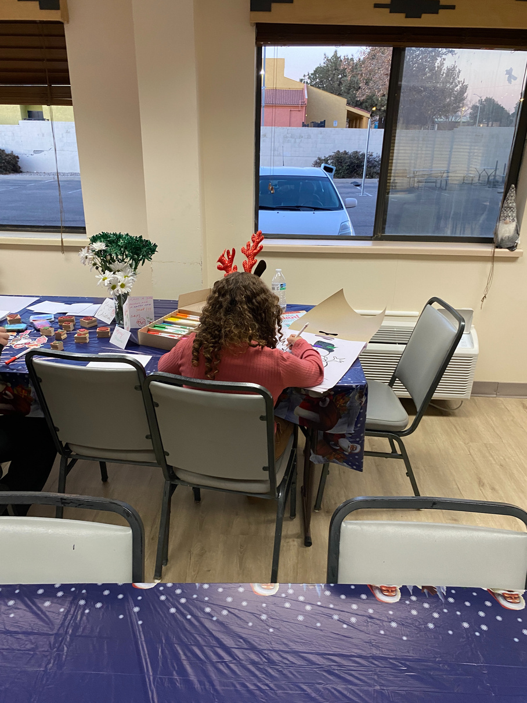
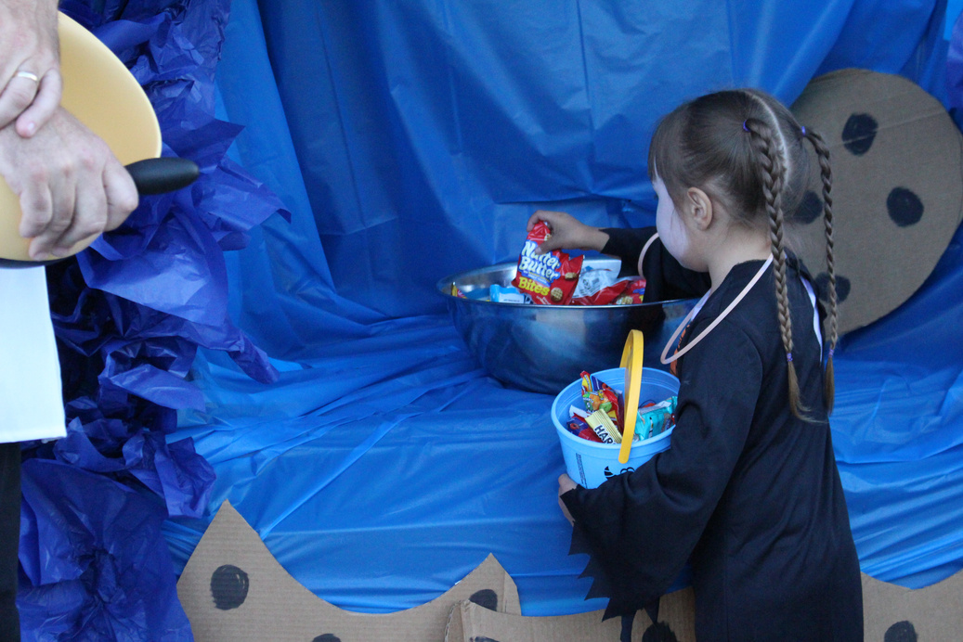
Gateway Family
  Undisclosed location
  Can serve 75 families at once
  826 people served in FY25
  Families receive wrap-around services
    Case management
    APS McKinney-Vento Program for kids
  Connection to a housing voucher
  Opened 2020

Slide 10
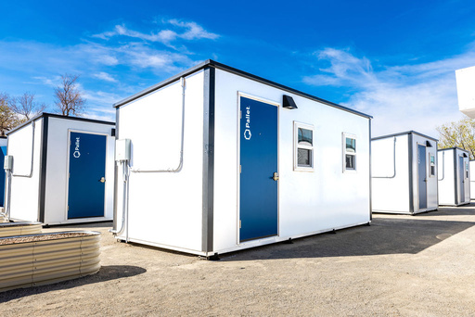
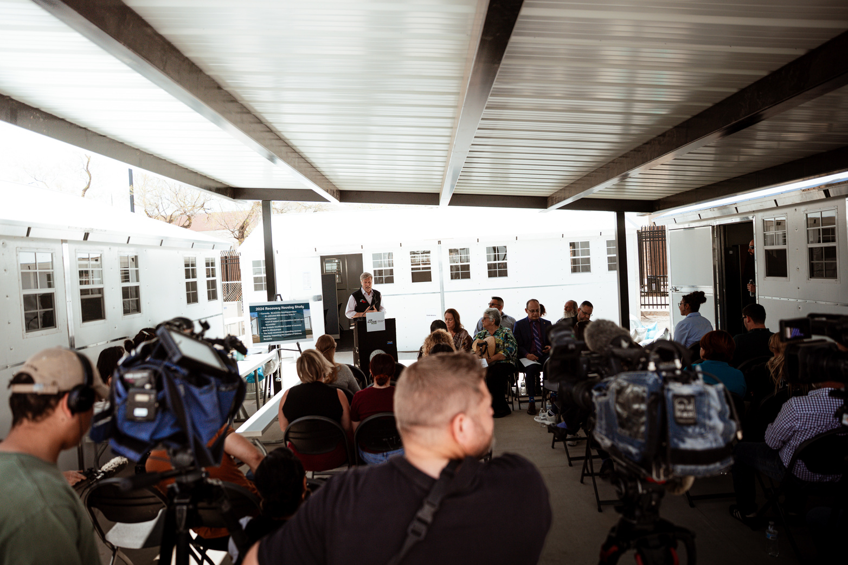
Gateway Recovery
  Designed to fill a gap in recovery housing
  Opened May 2025
  46 pallet homes, serving 50 clients
  24 month stay
  Case management, group and individual therapy, substance use disorder treatment, and more

Slide 11
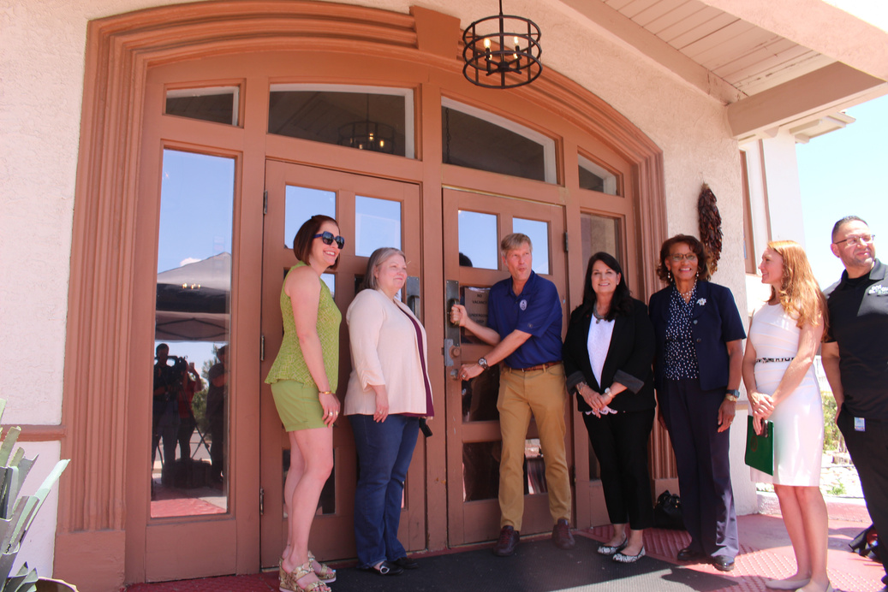
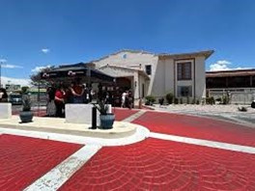
Gateway Young Adult
  More appropriate space for young adults
  Under Construction
  Will serve 42 Young Adults at a time; 168 per year
    Aged 18-25
  Wrap-around services, life skills to foster future success
  Expected to be open this winter

Slide 12
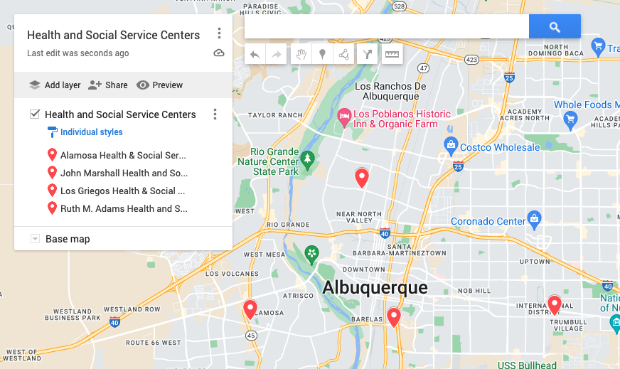
AVAILABLE RENTAL ASSISTANCE &
EVICTION PREVENTION
CABQ Health & Social Service Centers
  Alamosa - 505-836-8800
  Los Griegos - 505-761-4050
  John Marshal - 505-848-1345
  Ruth M. Adams - 505-767-5700

Slide 13
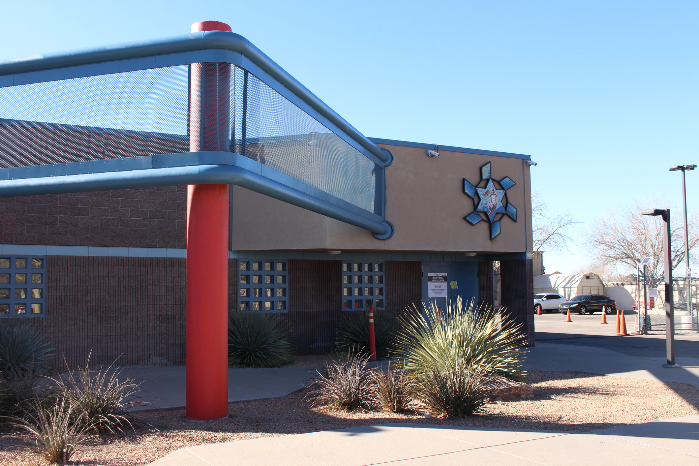

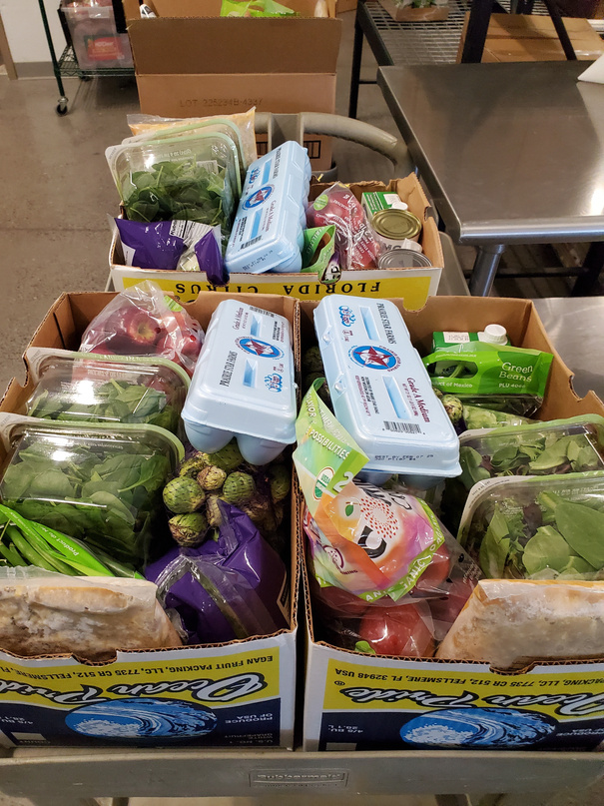


HEALTH AND SOCIAL SERVICES CENTERS 2024 HIGHLIGHTS
Rental assistance to 333 families totaling $675K
Utility assistance to 105 families totaling $41K
19,079 food boxes distributed
Provided diapers to 124 families and hygiene products to 243 people
Provided clothing to 261 families

Slide 14

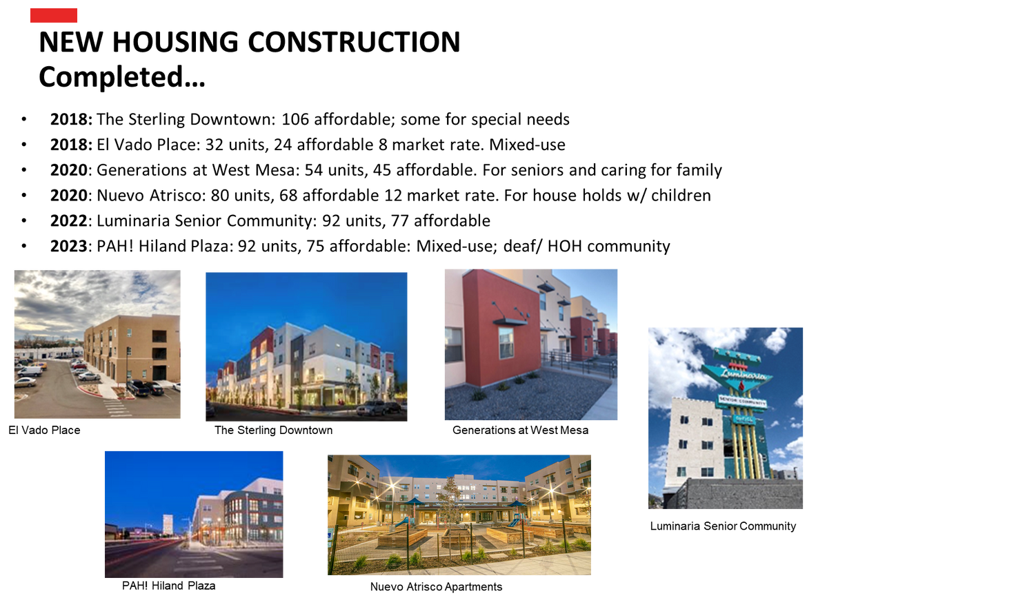
RECENTLY COMPLETED HOUSING PROJECTS
•2025: Calle Cuarta: 61 units, all affordable, mixed-use, retail space on first floor, up to 152 housed, ribbon cutting fall, 2025
•2025: Farolito Senior community: 82 units for seniors aged 55 and older, all affordable, ribbon cutting, Feb. 2006
•2026: Casitas Del Camino, 70 units, 59 affordable, preconstruction, summer 2025 groundbreaking
•2026: Somos Apartments, 88 affordable , pre-construction, summer 2025 groundbreaking
•2026: West Mesa Ridge A: 128 affordable units, pre-construction, fall 2025 groundbreaking
•2026: Route 66 Flats: 47 affordable units, under construction, ribbon cutting, fall 2025
•2026: Park Central: 110 units, 41 affordable units, groundbreaking, winter 2026

Slide 15
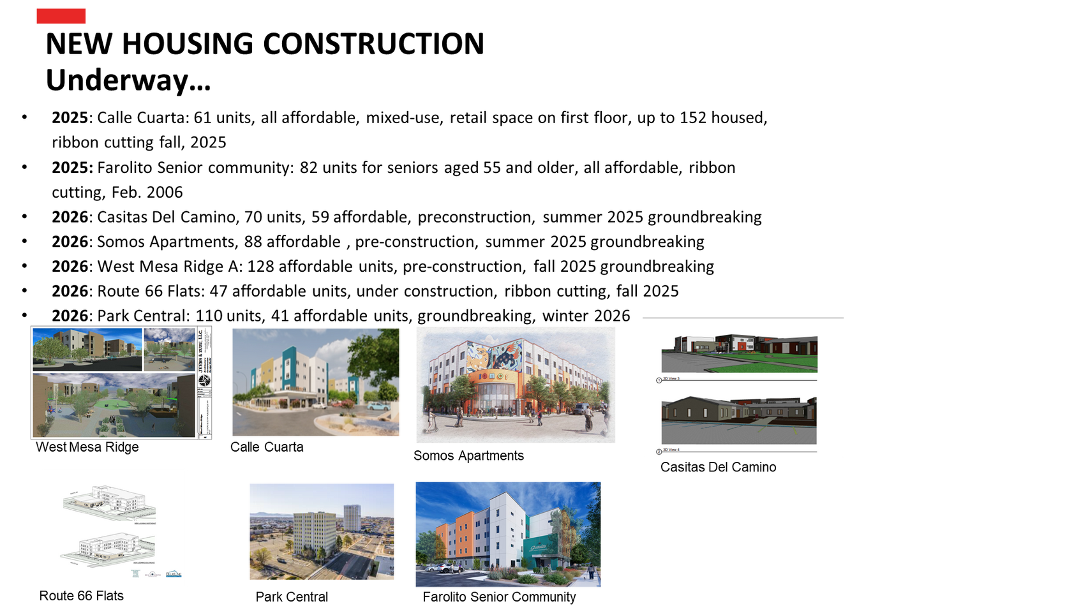
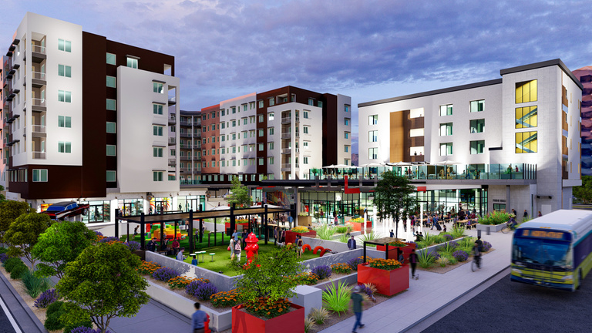
NEW HOUSING CONSTRUCTION
•2025: Calle Cuarta: 61 units, all affordable, mixed-use, retail space on first floor, up to 152 housed, ribbon cutting fall, 2025
•2025: Farolito Senior community: 82 units for seniors aged 55 and older, all affordable, ribbon cutting, Feb. 2006
•2026: Casitas Del Camino, 70 units, 59 affordable, preconstruction, summer 2025 groundbreaking
•2026: Somos Apartments, 88 affordable, pre-construction, summer 2025 groundbreaking
•2026: West Mesa Ridge A: 128 affordable units, pre-construction, fall 2025 groundbreaking
•2026: Route 66 Flats: 47 affordable units, under construction, ribbon cutting, fall 2025
•2026: Park Central: 110 units, 41 affordable units, groundbreaking, winter 2026
•2026: Uptown Connect: 430 units, 215 mixed-rate units, groundbreaking expected winter of 2026
Uptown Connect

Slide 16
Women's Housing and Treatment Navigation Center:
Operator Chicanos Por La Cause can be reached at: 505-224-6902
Men's Housing and Treatment Navigation Center:
Operator Community Bridges Inc. can be reached at: 505-224-6895
Family Housing and Treatment Navigation Center:
Youth Development Inc:(505) 352-3444
Young Adult Housing and Treatment Navigation Center: Youth Development Inc: (505) 352-3444
Gateway Recovery
Referrals to Gateway Recovery are by provider only.
Referrals
Download the full referral packet.
Medical Sobering
Horizons Medical Group
First Responder Drop off and Referral
First Responders Receiving Area
Operator Community Bridges Inc.
First Responder Drop off and Referral
Refer a Client
Guests are accepted into the Gateway Center by service provider referral only.
If you need to obtain a referral, contact a local homeless service provider.
Medical Respite
AHCH
UNM Hospital Referral

Slide 17
QUESTION AND ANSWER

